Slide 1
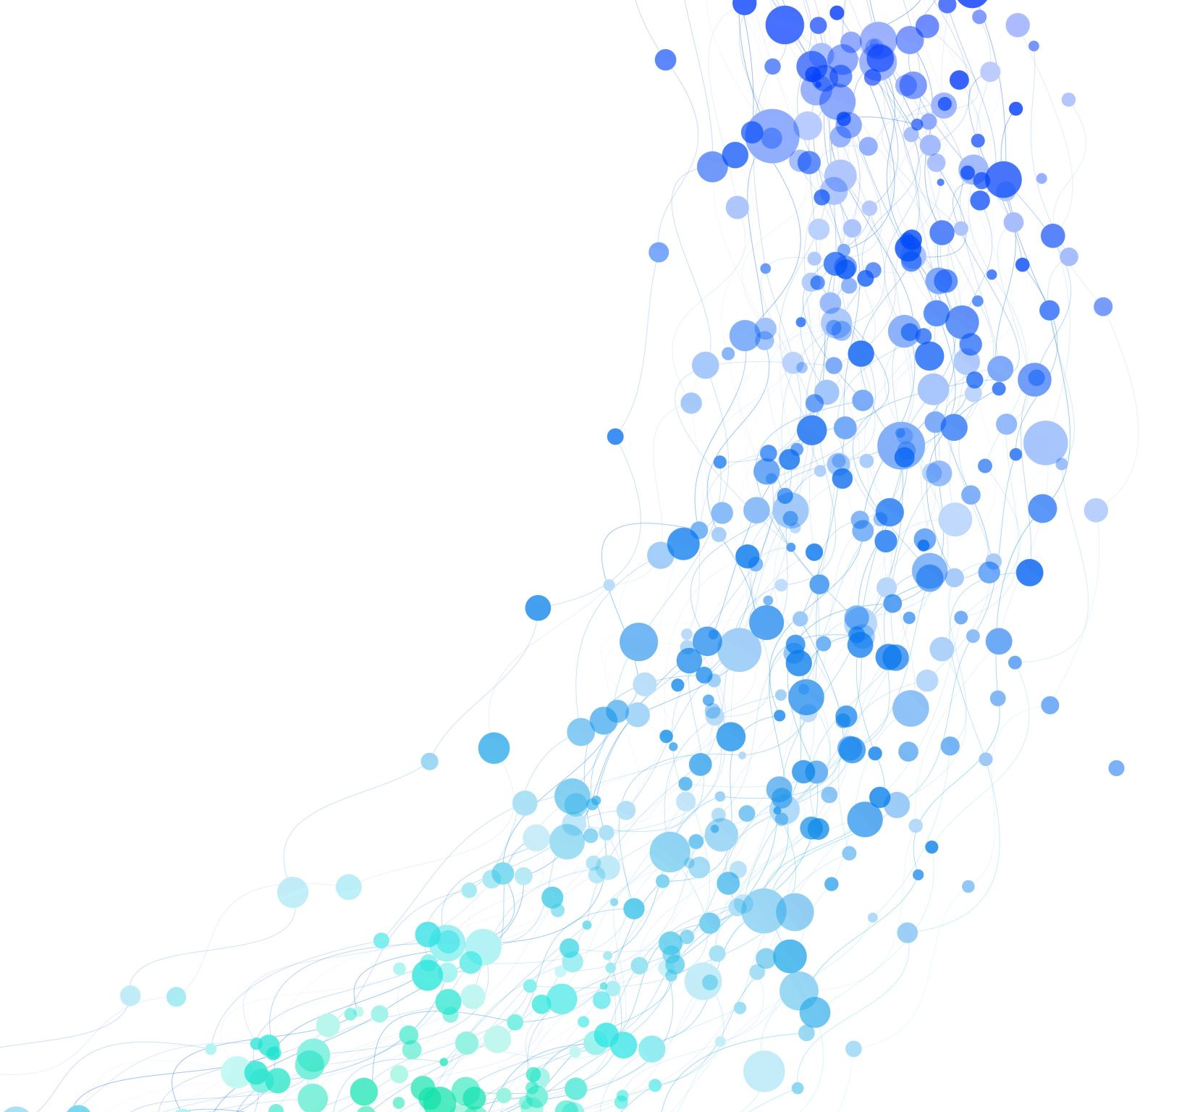
Many Body Post-Minkowski Simulation

Slide 2
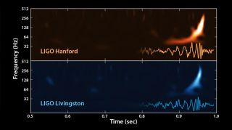
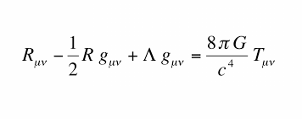
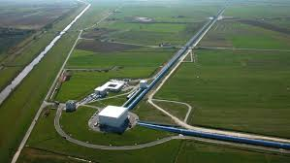
Gravitational Waves
The waveform from the first gravitational waves detected in 2015.
Notes:
More slides here; roughly one slide per minute.
Mention later detections of gravitational waves as well; include stellar graveyard graphic.
Takes two months to run a code at the production level needed to analyze GW.
Motivate having a template library more.

Slide 3
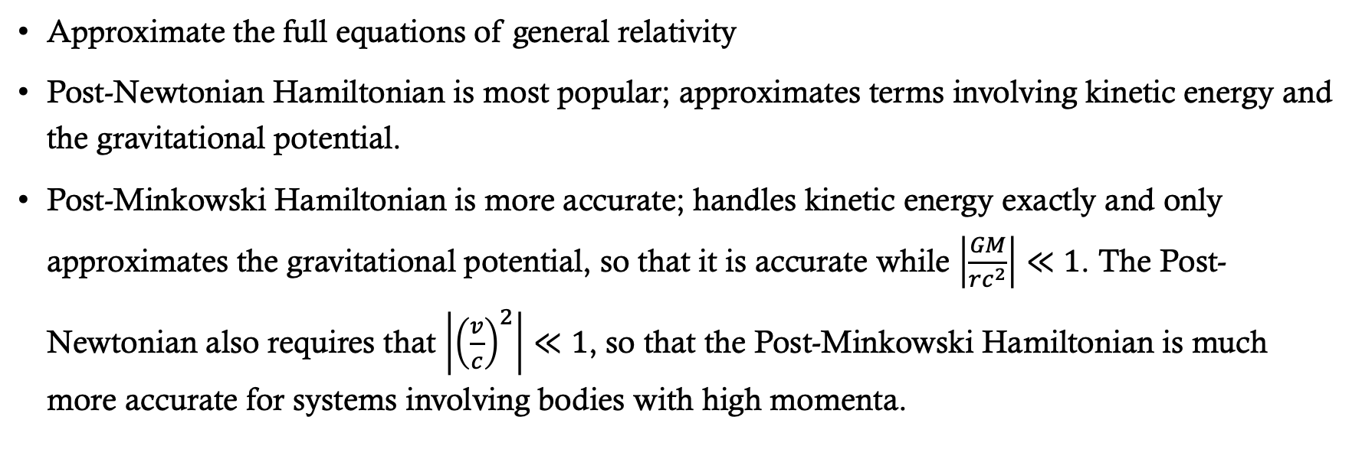
Post-Minkowski Approximation
Approximate the full equations of general relativity
Post-Newtonian Hamiltonian is most popular; approximates terms involving kinetic energy and the gravitational potential.
Post-Minkowski Hamiltonian is more accurate; handles kinetic energy exactly and only approximates the gravitational potential, so that it is accurate while $\left|\frac{GM}{rc^{2}}\right|≪1$. The Post-Newtonian also requires that $\left|{\left(\frac{v}{c}\right)}^{2}\right|≪1$, so that the Post-Minkowski Hamiltonian is much more accurate for systems involving bodies with high momenta.
Notes:
Too many words. They won’t listen to what you’re saying.
Do a compare/contrast between PN and PM.
Talk about what a Hamiltonian as, add another slide after this.

Slide 4
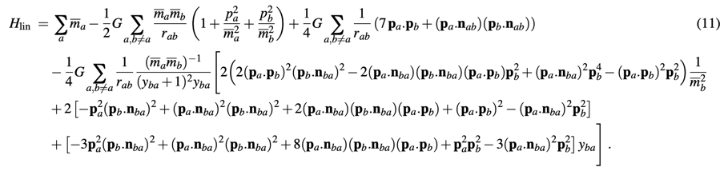
Post-Minkowski N-body Equation to First Order in G
We have written a code to solve this in equation in Julia, using their suite of advanced ODE solvers.
Notes:
PM is to second order for two-body, just n-body is only to 1st order. PN has just been worked on for longer.
Add some slides to talk about motivation; talk about massive black holes observed, we don’t have simple explanations for their formation. Dynamical capture.

Slide 5
Examples
Notes:
Talk about how these are dynamical situations where these massive black holes could form.

Slide 6
Problem of Initial Conditions
Correct initial conditions will produce a circular orbit. The example shown here is the animation of the orbital paths of two bodies with a mass ratio of 2.
What it should look like
What the code is producing
Notes:
Don’t focus too much on this
Concisely talk about each possible explanation and how we would check it.

Slide 7
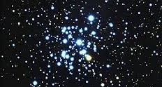
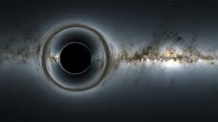
Up next

